Slide 1
Outdoor Testing Result Analysis
Prepared by Steven

Slide 2
Test One: Threshold Testing
 | Uncovered | Covered
1 | 647 | 565
2 | ?? | ??
3 | 679 | 569
4 | 674 | 522
5 | 730 | 573
6 | ?? | ??
7 | ?? | ??
8 | 705 | 573
9 | 686 | Failed to transmit
10 | ?? | ??

Slide 3
Test Two: Threshold Testing
 | Covered (Test 2) | Covered (Test 1)
1 | 573 | 565
2 | ?? | ??
3 | 574 | 569
4 | 569 | 522
5 | 572 | 573
6 | ?? | ??
7 | ?? | ??
8 | 572 | 573
9 | 585 | Failed to transmit
10 | ?? | ??

Slide 4
Threshold Testing
Min average when the sensors are uncovered: 647.
Max average when the sensors are covered: 573.
Threshold: 610.

Slide 5
Test the Robustness of threshold 610
Based on existing data from 1, 3, 4, 5, 8.
Threshold before car reaches the slot: OK.
Threshold after the car reaches the slot: sensor 3 has a sequence of 14 data that is greater than 610. Sensor 8 has a sequence of 6 data that is greater than 610.
Manually adjust threshold to 620

Slide 6
Test the Robustness of threshold 610
Before: Max sequence 1.
After: Max sequence 6.

Slide 7
Test 2: Packet Delivery Performance
 | Drop rate | Max Delay | Distance from Ground
1 | 0.086 | 8 | 25
2 | 0.082 | 6 | 115
3 | 0.106 | 7 | 88
4 | 0.179 | 10 | 88
5 | 0.015 | 2 | 15
6 | 0.592 | 112 | 17
7 | 0.039 | 6 | 25
8 | 0.150 | 9 | 107
9 | 0.183 | 9 | 27
10 | 0.711 | 59 | 23

Slide 8
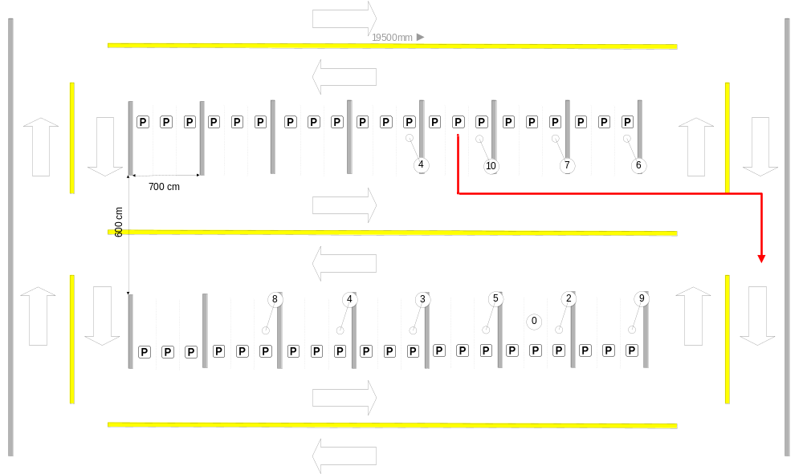
Test 2: Deployment

Slide 9
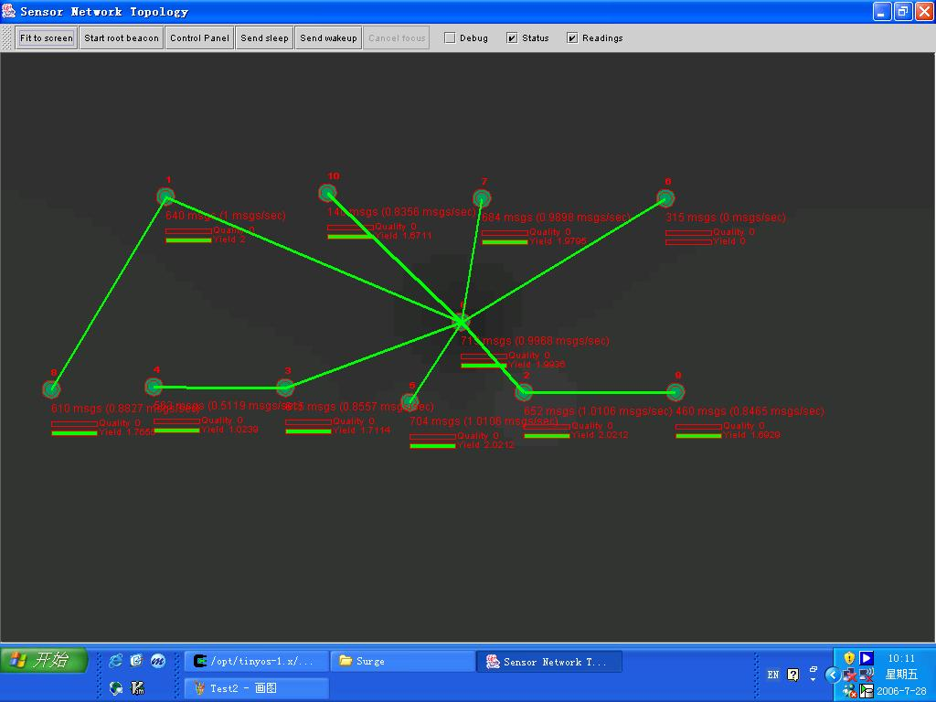
Test 2: Topology

Slide 10
One Hop, Nearest
 | Drop rate | Max Delay | Distance from Ground
2 | 0.082 | 6 | 115
5 | 0.015 | 2 | 15

Slide 11
1 Hop, Farther
 | Drop rate | Max Delay | Distance from Ground
1 | 0.086 | 8 | 25
3 | 0.106 | 7 | 88
6 | 0.592 | 112 | 17
7 | 0.039 | 6 | 25
10 | 0.711 | 59 | 23

Slide 12
2 Hops with Parents
 | Drop rate | Max Delay | Distance from Ground
4 | 0.179 | 10 | 88
8 | 0.150 | 9 | 107
9 | 0.183 | 9 | 27
 | Drop rate | Max Delay | Distance from Ground
3 | 0.106 | 7 | 88
2 | 0.082 | 6 | 115
1 | 0.086 | 8 | 25

Slide 13
A Word on MintRoute
MintRoute is an enhanced version of the default Multihop routing protocol provided by TinyOS.
How does the original protocol works?
  Each mote periodically broadcasts ‘route update’ messages.
  Upon receiving those ‘route update’ messages, each sensor determines the link quality by counting how many messages it receives / loses from each of the neighbor.
  Choose a parent based on hop count and link quality.

Slide 14
Which Parts Does MinteRoute Improve?
Parent selection
Message Forwarding

Slide 15
Parent Selection
Original Method
  Specify a lower bound. All the neighbors that has a link quality better than this will be chosen as candidates.
  Select one based on minimum hop count.
New Method
  Similar to the old method but before selecting a new parent, its link quality must be better than the old one.
  How much better? Defined in SWITCH_THRESHOLD

Slide 16
Message Forwarding
Original Method:
  When a packet is received, forward it to the parent.
New Method:
  Added one more feature. The basic idea is: when a packet is received, check its original address. Later when choosing parent, that address WILL NOT be chosen as a candidate.

